Slide 1
Threat Modeling for Enterprise Architecture
Architecture Design with Security in Mind

Slide 2
Brief recap:
Company: I.T.S (Internet Technology Systems)
Working with Architecture team who design various solutions designs for the UOA
Also working with the Security Team who oversee web security for the UOA
Project goal: To create a tool/process that incorporates threat modeling into Enterprise Architecture that can be used by I.T.S and any I.T companies

Slide 3
Agenda:
Project Intro
What is threat modeling?
Who does threat Modeling?
Why do we Threat Model- ie: What is the motivation for threat modeling. What are the business benefits?
Project goal- Explain
What I’ve done so far with I.T.S
Plan for semester 2- what is left to do.

Slide 4
Project Intro
Using threat models to create a process that can be used by enterprise architecture to incorporate security into their designs
Injecting threat modeling at early stage of a high level solution design to maximise its benefits
Whiteboard stage- first draft of design

Slide 5
What is Threat Modeling?
Threat Modeling: A structured approach to identifying, quantifying and addressing potential threats
For this project, it helps the architects identify early on where the bugs and vulnerabilities lie within their high level designs so that they can make amendments at an early stage where changes will be inexpensive.

Slide 6
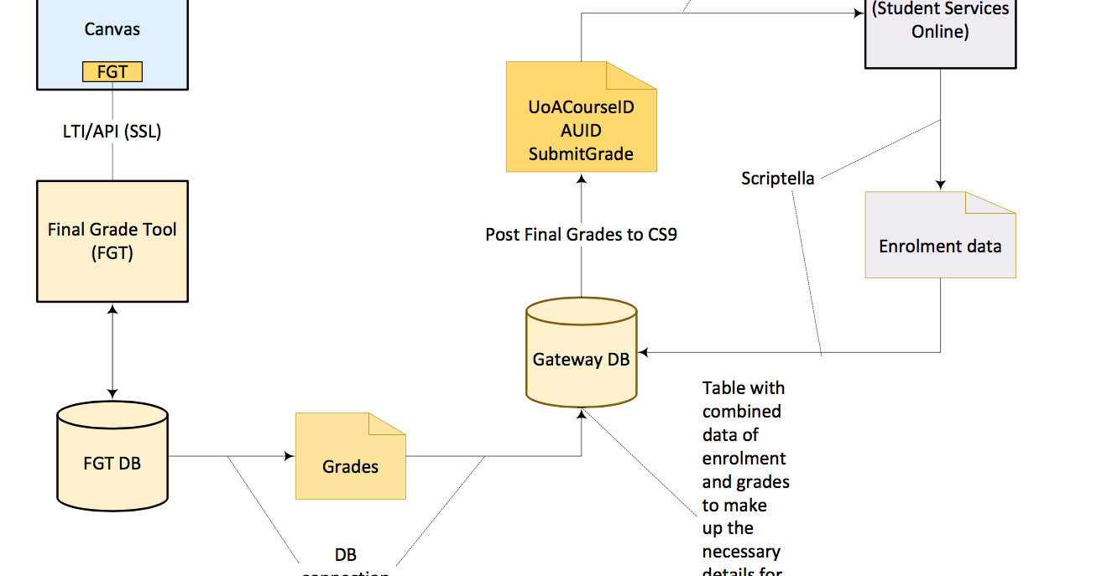
What is Threat Modeling?

Slide 7
Who does threat Modeling?
Everybody Threat models- we do it intuitively on a daily basis
Architecture: Think about possible ways intruders could enter yr home.
Prioritize Assets to Protect (e.g. TV, Jewelry, Family Heirlooms, Money)
Types of attackers: Cat burglars, neighborhood kids, stalkers etc.
All the above have an analogous counterpart in the IT world- ie: Architecture web design and Security

Slide 8
Three Pigs and the big bad wolf
Quick analogy for how threat modeling is relevant for Enterprise Architecture Design
Think of Three pigs as web architects-Think of big bad wolf as threat/hacker or vulnerability to system
Each pig built house with the design goal in mind- provide roof over head-place to live-they all succeed in this goal
But only one pig designed house with security in mind also!!
In another version of the story, the pigs with the straw house and stick house get security advice to build a gate and reinforce their walls, but they’ve already built the house and chosen the location so these changes are now expensive.

Slide 9
Why do we threat model?
1) Identify and mitigate issues early in the development stages-
-Avoid misunderstanding cust requirements
-Might be hard/impossible/expensive to fix later
2) Explore implications of design decisions-
3) Build mitigations into the design, not afterwards, where you’d rely on expensive security patches etc
However-Threat modeling does not guarantee your system is 100% secure

Slide 10
STRIDE recap
STRIDE- way of catergorising potential threats
Spoofing- Impersonating another Person
Tampering- Unauthorised alterations
Repudiation- Denying claims/unproven action
Information disclosure –exposure to unauthorized person/process
Denial of Service- Service unavailability
Elevation of Privilege- Increasing person/process access level

Slide 11
Why do we Threat Model?
Context of UOA- a few examples
Spoofing- someone could access your UOA details by pretending to be you-stealing password or using social engineering
Tampering-A flaw in the design could allow someone to intercept and alter information between 2 endpoints-change an C grade to an A+ or vice versa
Information Disclosure- A flaw in design could lead to unintended consequences ie: Students being able to view their raw exam marks on Canvas before SSO grade.

Slide 12
Project Goal
To create a tool/process that incorporates threat modeling into Enterprise Architecture that can be used by I.T.S and any I.T companies on a wider scope
This process will involve having high level designs threat modeled during the early whiteboard/conceptual stages
By the projects end, we should have a practice that systematically captures threats and can be useful to all security based network teams in a wider context, from the design planning stages, to deployment, to operations delivery where threat modelling can be integrated at all of these stages of the process in order to strengthen network security architecture.

Slide 13
Work done so far with I.T.S
There are many ways to threat model.
Experimenting with different cuts of the threat models, trying to find which one will work best-
“All models are wrong, some are useful” (George Box)
For this project, I am using the Microsoft threat modeling tool to model the “Final Grading Tool”
Perform a STRIDE based gap analysis-comparing what threat model finds with threats found by existing security practices.

Slide 14
Threat Model Criteria
a threat model does not introduce non-existant vulnerabilities
A threat model improves on security testing
A strong threat model identifies security vulnerabilities not tested by security teams and not covered by infrastructure

Slide 15
Threat Model Criteria
Threat Model
Infrastructure
Security Testing

Slide 16
Work done so far with I.T.S
Researched into different types of possible threat models
Decided on STRIDE based Microsoft threat modeling tool to trial first
Advantages: Does not require specialized security knowledge-Easy for architects to understand and use
Once model is built-tool auto-populates threats and categorizes them via STRIDE method
Standard mitigations exist for each STRIDE threat so listing bugs via the tool can be done by anyone. Analysis of bugs, however, will need a security expert

Slide 17
Work done so far with I.T.S
Threat Modelling the “Final Grading Tool” to evaluate the Microsoft STRIDE based threat model tool
Threat Modelling is like playing an instrument, it takes time to perfect (Adam Schostack)
Have had to create several cuts of the final grading tool, to see which ones fit the criteria of a good threat model-

Slide 18
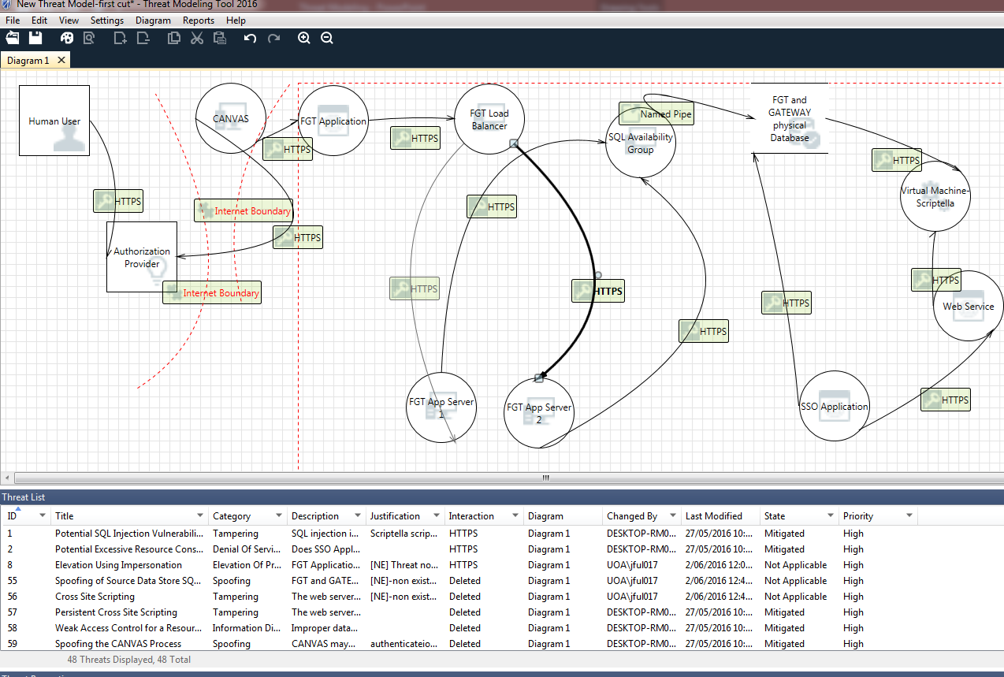
Threat model Cut of Final Grading Tool

Slide 19
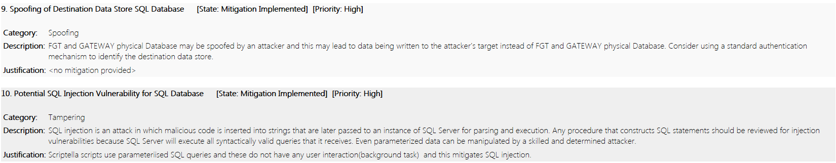
Closer Look

Slide 20
What have learned after trial and error
First cut of the threat modelling tool was as close to physical representation of Final grading tool as possible- gave us threats that did not exist which violated our criteria for a good threat model
After several different cuts, with increasing abstraction added to model, we hoped to make NE threats disappear
However, the threat model identified a few threats that were not picked up by the security team and not already mitigated for, by the infrastructure
Concluded that we could have a threshold for number of NE threats in our model and still be a good threat model

Slide 21
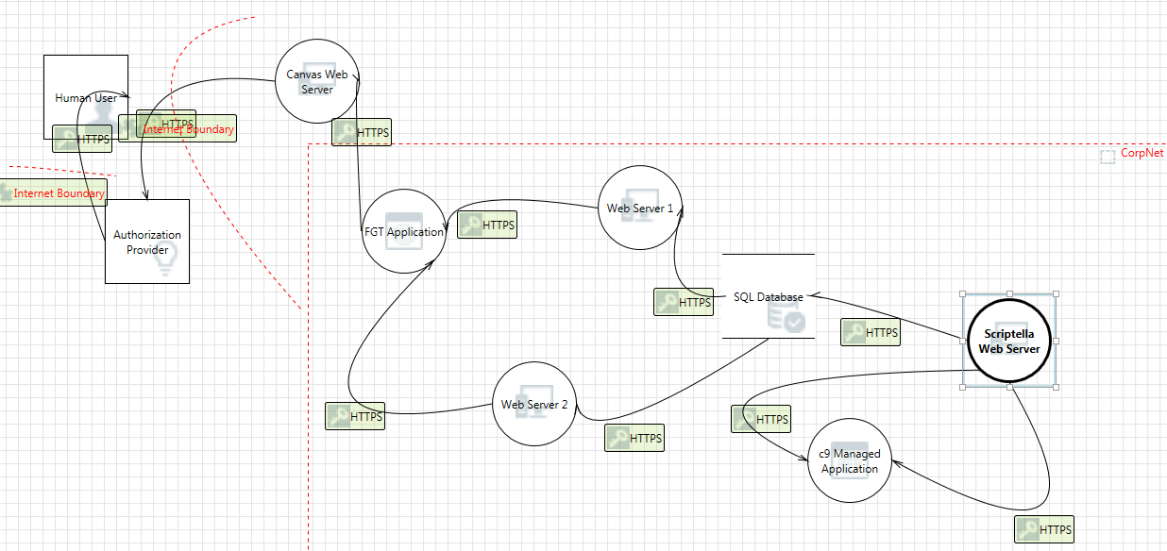
2nd cut

Slide 22
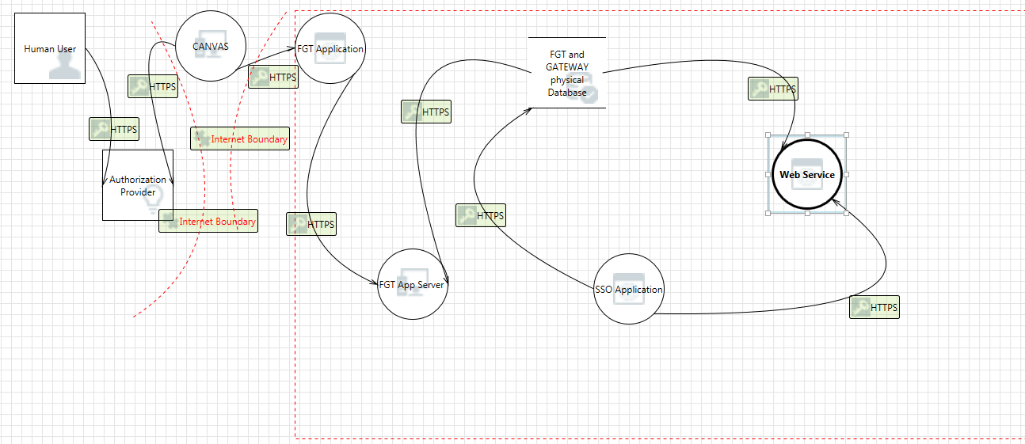
3nd Cut

Slide 23
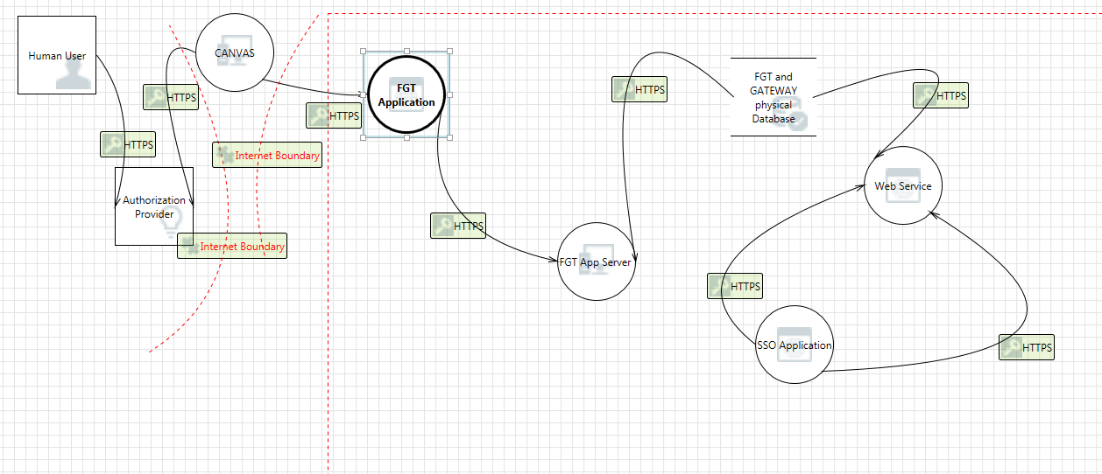
4th cut

Slide 24
Plan for Semester 2
Further testing of the Microsoft threat modeling tool- experimenting with different cuts to get the model right-or as close as possible
Trying other threat model options- DREAD, TRIKE etc and another threat modeling tool - Mozilla seasponge
https://mozilla.github.io/seasponge/#/draw
If have time I’ll do a quick demonstration of the seasponge tool

Slide 25
END of presentation
This semester I will be doing some security and networking papers to help me with this project-namely- Compsci 726 for security
I hope to have shown that threat modeling adds value to the security and architecture design process and achieve the project end goal
Thanks for your Time

